Slide 2
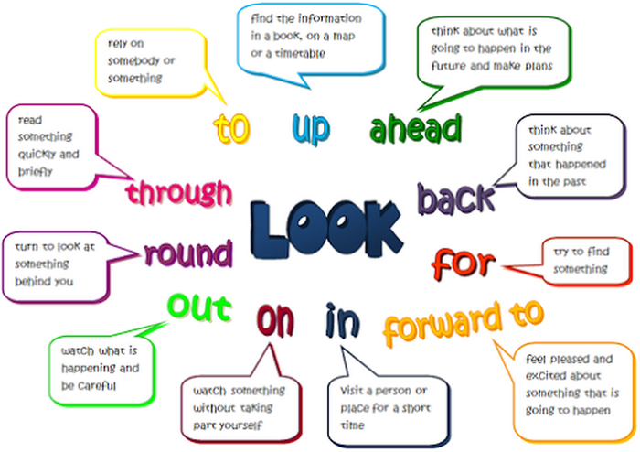

Slide 3
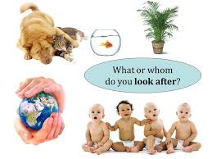
Look after Meaning: Take care
Example:
Their auntie LOOKED AFTER them while their mother was in hospital.

Slide 4
Look back Meaning: Think about the past
Example:
Old people often LOOK BACK on over their lives.

Slide 5
Look for Meaning: Try to find
Example: I've been LOOKING FOR all their hidden files, but I can't find them anywhere.

Slide 6
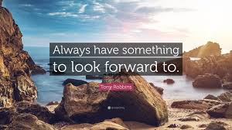
Look forward to Meaning: Wait for or anticipate something pleasant
Example:
I'm LOOKING FORWARD TO meeting you.

Slide 7
Look in Meaning: Make a quick visit
Example:
I'll LOOK IN on my way home.

Slide 8
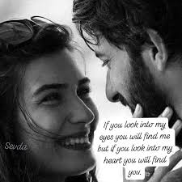
Look into Meaning: Research, investigate
Example:
We'll LOOK INTO the problem and come back to you when we have the information.

Slide 9
Look on Meaning: Watch something like a crime without helping
Example:
The crowd just LOOKED ON as the old lady was mugged.

Slide 10
Look in on Meaning: Visit briefly to see if everything's all right
Example:
I'm going to LOOK IN ON grannie on the way home tonight as she's been a bit unwell recently.

Slide 11
Look on as Meaning: Consider, regard
Example:
I LOOK ON her AS a close friend.

Slide 12
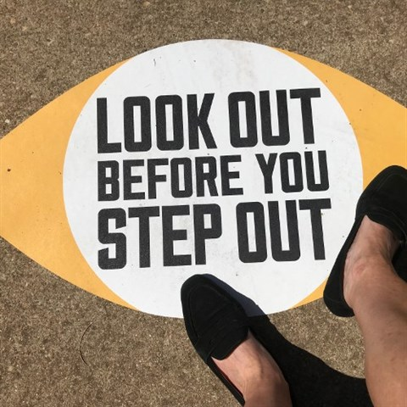
Look out Meaning: Be careful
Example:
LOOK OUT; you're going to drop that!

Slide 13
Look out for Meaning: Take care of someone, make sure someone is cared for
Example:
She LOOKED OUT FOR her sister when she started school.

Slide 14
Look out for Meaning: Keep alert and try to see
Example:
We we told to LOOK OUT FOR any suspicious behaviour.

Slide 15
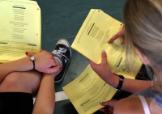
Look over Meaning: Inspect
Example:
They came to LOOK the house OVER with a view to buying it.

Slide 16
Look round Meaning: Inspect a house
Example:
We LOOKED ROUND the house and decided that we didn't like it enough to buy it.

Slide 17
Look through Meaning: Read quickly
Example:
I LOOKED THROUGH the article.

Slide 18
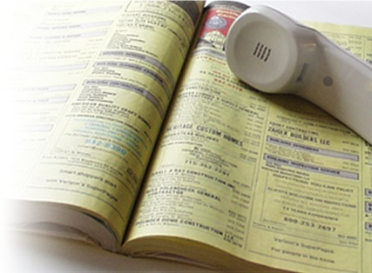
Look up Meaning: Consult a reference work (dictionary, phonebook, etc.) for a specific piece of information.
Example:
I didn't know the correct spelling so I had to LOOK it UP in the dictionary.

Slide 19
Look to Meaning: Expect, hope
Example:
The company is LOOKING TO increase its sales in Asia.

Slide 20
Look up Meaning: Improve
Example:
The economy is LOOKING UP.

Slide 21
Look up Meaning: Find, trace an old friend
Example:
I LOOKED him UP when I went back to Cambridge.

Slide 22
Look up to Meaning: Respect
Example:
She's LOOKS UP TO her mother.

Slide 23
Look upon as Meaning: Consider, regard
Example:
I LOOK UPON him AS a close friend.

Slide 25
Best wishes Hasmik Mayilyan Ararat Vosketap High School

